Slide 1
MOSDEX and the Architecture of Optimization-Based Decision Support Applications
Dr. Jeremy A. Bloom jeremyblmca@gmail.com September, 2020

Slide 2
Outline
Data Flow for an Optimization Application
MOSDEX Architecture
MOSDEX Object Model
Solver Modeling Object – Adapter and Factory
How MOSDEX Supports the Dataflow
Big Data and Streams

Slide 3
Dataflow for an Optimization Application
Extract and Validate Data
Transform
Create Solver Objects
Frequently, computational effort involved in these steps is unrecognized
Solve
Extract and Transform Solution

Slide 4
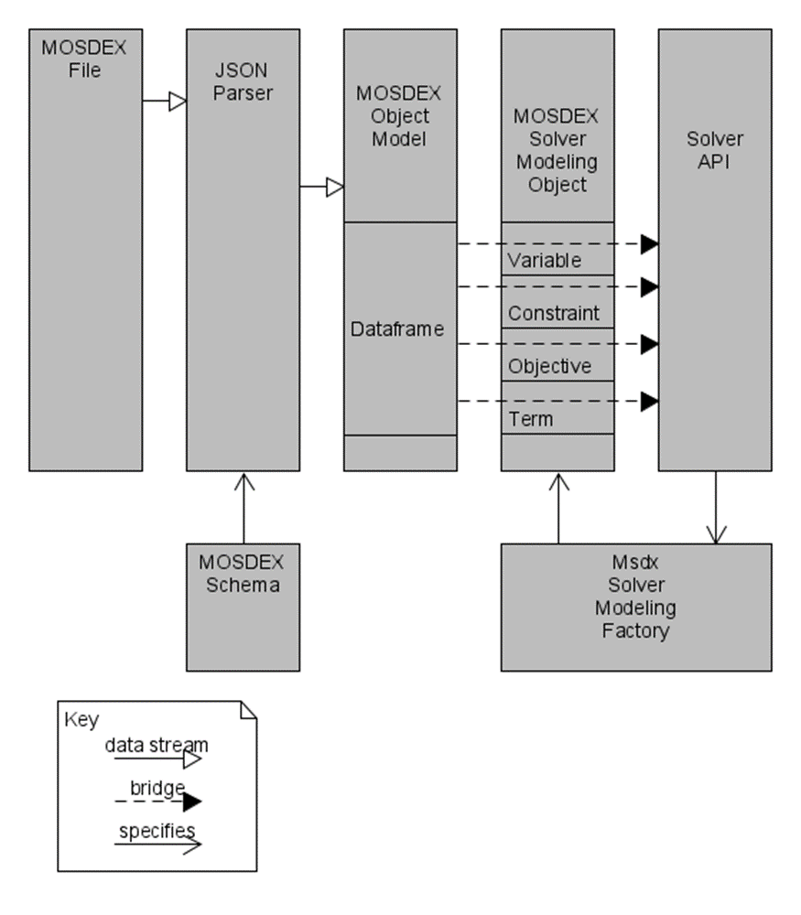
MOSDEX Architecture

Slide 5
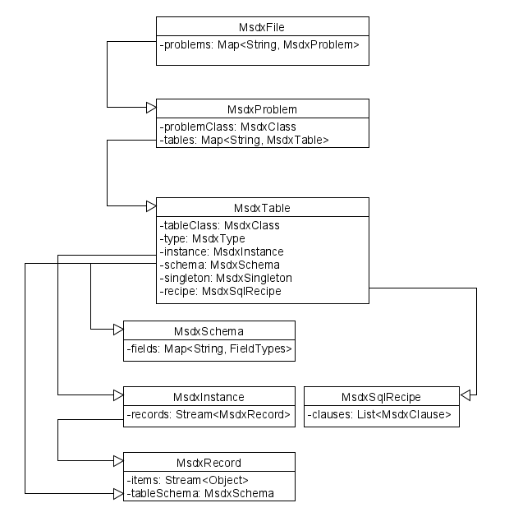
MOSDEX Object Model
FILE contains one or more named PROBLEMS
A FILE is intended to be self-contained but may link to other FILES
PROBLEM contains one or more named TABLES plus auxiliary keyword objects
A PROBLEM may contain a full optimization problem, data only, or a module of a decomposition
TABLE is the fundamental data structure of MOSDEX
Think of a table in a relational database with a fixed number of columns and an indefinite number of records (rows)
A TABLE’s class is DATA or a modeling object – VARIABLE, CONSTRAINT, OBJECTIVE, or TERM
A TABLE’s type depends on its class – e.g. VARIABLE types are CONTINUOUS, INTEGER or BINARY
A modeling object TABLE represents a family of related objects differentiated by a key. A key (i.e. subscript) can have one or more dimensions
A TABLE can have either Instance form or Query form

Slide 6

MOSDEX Object Model (continued)
Instance-form TABLE contains data
Query-form TABLE is specified by an SQL query
Singleton TABLE is a special instance that contains a single record
Every TABLE has a SCHEMA
Specifies the name and datatype of each field (column) in the TABLE
Instance TABLE has explicit SCHEMA
Query TABLE has SCHEMA implied by the query
Singleton TABLE has SCHEMA implied by the data
Data TABLE can have any reasonable schema Modeling object TABLE has a schema dictated by the solver
PROBLEM can contain a mixture of instance, query, and singleton TABLES

Slide 7
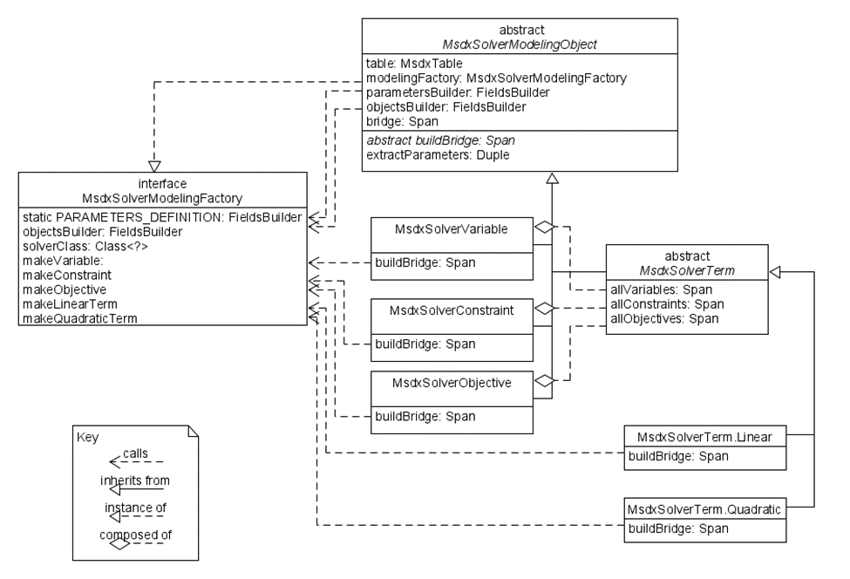
Solver Modeling Object – Adapter and Factory

Slide 8
How MOSDEX Supports the Dataflow
MOSDEX standardizes the dataflow
Query-form tables document extraction, validation, and transformation of data in a platform independent manner
MOSDEX parser translates JSON into the MOSDEX Object Model in the underlying programming language, e.g. C++, Java, Python, etc.
MODEX Object Model transforms into classes of the solver’s API, standardizing the solver interface
The solver’s API classes transform back into the MOSDEX Object Model which then provides access to the solution by the consuming applications; MOSDEX documents the execution of these transformations

Slide 9
The Future: Big Data and Streams
Analytics in general is moving strongly and rapidly to applications on big data sets
Optimization applications already support large data sets (O(1M) variables and O(100K) constraints and solvers on the horizon could increase instance sizes by another order of magnitude or more
Examples: control of millions of energy storage batteries in hybrid vehicles, stochastic electricity unit commitment, individualized marketing offers to millions of customers
Data handling tools such as Hadoop and Apache Spark can now process enormous data sets, using distributed, parallel processing
Data exchange format for optimization needs to be able to adapt to big data as well

Slide 10
Big Data Operations
Parallel Processing: Multi-processor architectures are becoming more common that permit operating on data sets in parallel
Streaming: Data flows from a source (e.g. file, Twitter feed, etc.) to a destination (e.g. an optimization solver) without an intermediate resting place
Creating intermediate objects can overwhelm the stack space of the processor
Streams can support parallel processing on multiple processors
Operators work directly on a stream rather than on the individual items in the stream (unlike an iterator)
Many languages now support some form of stream processing
Transformation: transform each row of a data set to a new row in another data set (e.g. a Map operation)
Terminal Action: produce a result, e.g. a scalar, that is not a data set (e.g. a Reduce action)
Big data handlers (e.g. Hadoop, Spark) are optimized to perform these operations efficiently.
Transformations are evaluated in lazy fashion; that is they are performed only when a action is initialed and they may be reformulated for efficient execution
Thus, to the extent possible, data handling operations should be performed inside a big data handler

